Slide 1
Firewalls
Notes:
THREATS TO INFORMATION SECURITY
To make sound decisions about information security, create policies, and enforce them, management must be informed of the various kinds of threats facing the organization, its applications, data and information systems.
A threat is an object, person, or other entity that represents a constant danger to an asset.
To better understand the numerous threats facing the organization, a categorization scheme has been developed allowing us to group threats by their respective activities.
By examining each threat category in turn, management can most effectively protect its information through policy, education and training, and technology controls.

Slide 2
General Framework
What is a firewall?
  A hardware device, a software package, or a combination of both
  A barrier between the Internet and an edge network (internal network)
  A mechanism to filter Incoming (ingress) and outgoing (egress) packets.
  May be hardware and/or software
    Hardware is faster but can be difficult to update
    Software is slower but easier to update
    A firewall is any device that prevents a specific types of information from moving between the outside world (untrusted network) and the inside world (trusted network).
The firewall may be
  a separate computer system
  a service running on an existing router or server
  a separate network containing a number of supporting devices

Slide 3
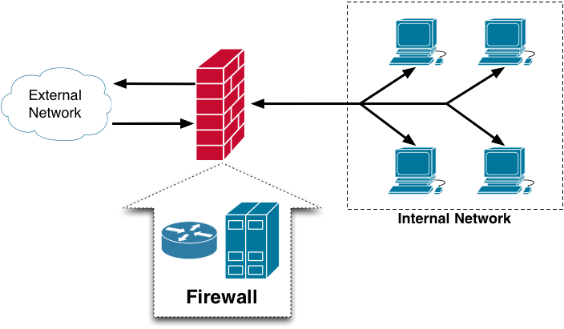
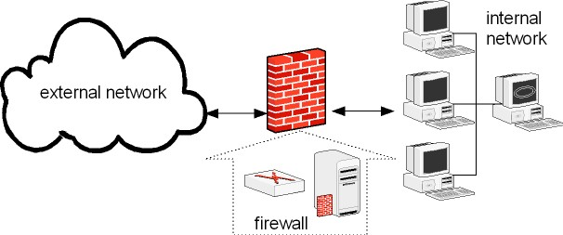
General Framework
  Firewall can be categorized by processing mode, development era or structure.
  There are five major processing mode categories of firewall: Packet Filtering Firewall, Application Gateways, Circuit Gateway, MAC layer Gateways and Hybrid Firewalls

Slide 4
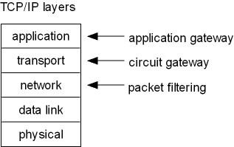
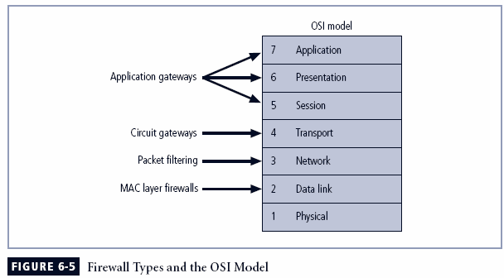
Firewalls Categorized by Processing Modes
Packet filtering
Application gateways
Circuit gateways
MAC layer firewalls
Hybrids
Notes:
Firewall Categorization Methods
Firewalls can be categorized by:
processing mode,
development era, or
intended structure.

Slide 5
Packet Filtering
Packet filtering firewalls examine header information of data packets
Most often based on combination of:
  Internet Protocol (IP) source and destination address
  Direction (inbound or outbound)
  Transmission Control Protocol (TCP) or User Datagram Protocol (UDP) source and destination port requests
Simple firewall models enforce rules designed to prohibit packets with certain addresses or partial addresses
Three subsets of packet filtering firewalls:
  Static filtering: requires that filtering rules governing how the firewall decides which packets are allowed and which are denied are developed and installed
  Dynamic filtering: allows firewall to react to emergent event and update or create rules to deal with event
  Stateful inspection: firewalls that keep track of each network connection between internal and external systems using a state table
Notes:
Packet Filtering
Packet filtering firewalls examine the header information of data packets that come into a network.
The restrictions most commonly implemented are based on a combination of:
Internet Protocol (IP) source and destination address
Direction (inbound or outbound)
Transmission Control Protocol (TCP) or User Datagram Protocol (UDP) source and destination port requests
Simple firewall models examine one aspect of the packet header: the destination and source address. They enforce address restrictions, rules designed to prohibit packets with certain addresses or partial addresses from passing through the device.
They accomplish this through access control lists (ACLs), which are created and modified by the firewall administrators.
There are three subsets of packet filtering firewalls:
Static Filtering
Dynamic Filtering
Stateful Inspection
Static filtering requires that the filtering rules governing how the firewall decides which packets are allowed and which are denied are developed and installed.
Dynamic filtering allows the firewall to react to an emergent event and update or create rules to deal with the event.
While static filtering firewalls allow entire sets of one type of packet to enter in response to authorized requests, the dynamic packet filtering firewall allows only a particular packet with a particular source, destination, and port address to enter through the firewall.
Stateful inspection firewalls, or stateful firewalls, keep track of each network connection between internal and external systems using a state table, which tracks the state and context of each packet in the conversation by recording which station sent what packet and when.
Whereas simple packet filtering firewalls only allow or deny certain packets based on their address, a stateful firewall can block incoming packets that are not responses to internal requests.
The primary disadvantage of this type of firewall is the additional processing required to manage and verify packets against the state table, which can leave the system vulnerable to a DoS or DDoS attack.

Slide 6
Packet Filters Contd.
Perform ingress (incoming) and egress (outgoing) filtering on packets
Only inspect IP and TCP/UDP headers, not the payloads
Can perform either stateless or stateful filtering
  Stateless filtering: easy to implement but very simple
  Stateful filtering: harder to implement but more powerful

Slide 7
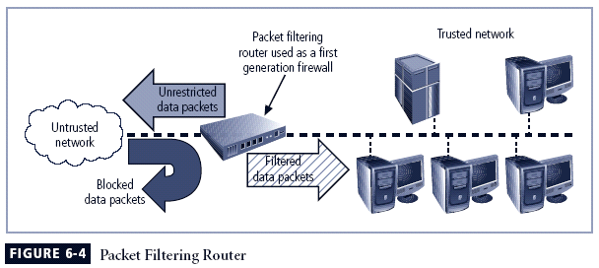
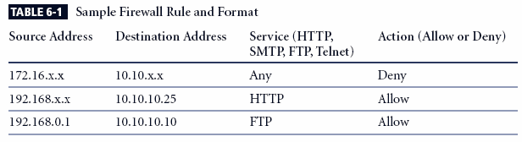
Packet Filters Contd.

Slide 8
Packet Filters Contd.
Can encrypted packet pass through Packet Filter Firewall ?

Slide 9
Packet Filters Contd.
There are three subsets of packet filtering firewalls:
    Static Filtering
    Dynamic Filtering
    Stateful Inspection
  Static Filtering
    Static Filtering requires that the filtering rules be developed and installed with the firewall.
    The rules are created and sequenced either by a person directly editing the rule set or by a person using a programmable interface to specify the rules and the sequence.
    This type of filtering is common in network routers and gateways

Slide 10
Packet Filters Contd.
  Dynamic Filtering
  Dynamic filtering firewall can react to an emergent event and update or create rules to deals with that event.
  Dynamic packet filtering firewall allows only a particular packet with a particular source, destination and port address to enter through firewall.
  It does this by opening and closing doors in the firewall based on the information contained in the packet header which makes dynamic packet filters an intermediate form between traditional static packet filters and application proxies

Slide 11
Packet Filters Contd.
  Stateful Inspection Firewall
  Also called as stateful firewall.
  It keeps track of each network connection between internal and external system using a state table.
  A state table tracks the state and context of each packet in the conversation by recording which station sent what packet and when.
  Whereas simple packet filtering firewalls only allow or deny certain packet based on their address, a stateful firewall can expedite informing packets that are responses to internal requests.
  If the stateful firewall receives an incoming packet that it cannot match in its state table, it refer to its ACL to determine whether to allow the packet to pass.
  The primary disadvantage of this type of firewall is the additional processing required to manage and verify packets against the statetable

Slide 12
Application Gateways
Also called application-level gateway or proxy server
Act like a proxy for internal hosts, processing service request from external clients.
Perform deep packet inspection on all packet
  Inspect application program formats
  Apply rules based on the payload
  Have the ability to detect malicious and suspicious packets
Extremely resource intensive

Slide 13
Application Gateways
Application Gateway also know as Application Level Gateway or Application Firewall
Frequently installed on a dedicated computer, separate from the filtering router, but it is commonly used in conjunction with a filtering router.
It is also known as a proxy server, since it runs special software that acts as a proxy for a service request.
Proxy server is placed in an unsecured area of the netwrok or in the demilitarized zone (DMZ) – an intermediate area between a trusted network and untrusted netwok.
Additional filtering routers can be implemented behind the proxy server, further protecting internal systems
The primary disadvantage of application -level firewall is that they are designed for one or a few specific protocol and cannot easily be reconfigured to protect against attack on other protocols.
Notes:
Application Gateways
The application gateway, application-level firewall or application firewall, is frequently installed on a dedicated computer, separate from the filtering router, but is commonly used in conjunction with a filtering router.
The application firewall is also known as a proxy server, since it runs special software that acts as a proxy for a service request.
Since the proxy server is often placed in an unsecured area of the network or is placed in the DMZ it, rather than the Web server, is exposed to the higher levels of risk from the less trusted networks.
Additional filtering routers can be implemented behind the proxy server, limiting access to the more secure internal system, and thereby further protecting internal systems.

Slide 14
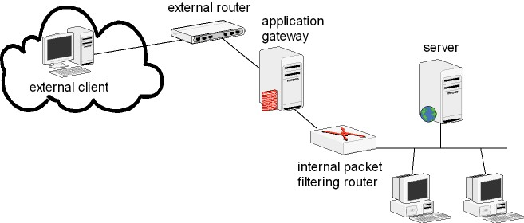
Application Gateways
Place a router behind the gateway to protect connections between the gateway and the internal hosts

Slide 15
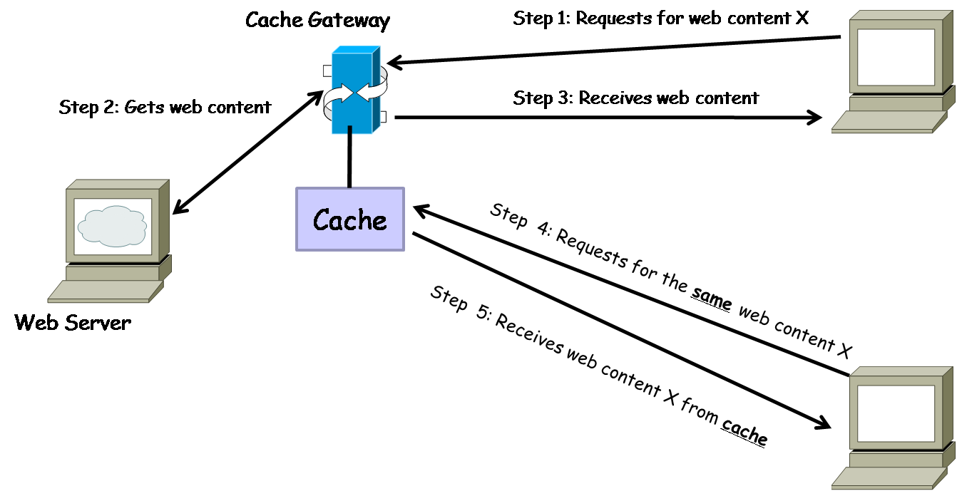
Cache Gateway

Slide 16
Circuit Gateways
Circuit gateway firewall operates at transport layer
Like filtering firewalls, do not usually look at data traffic flowing between two networks, but prevent direct connections between one network and another
Accomplished by creating tunnels connecting specific processes or systems on each side of the firewall, and allow only authorized traffic in the tunnels
Notes:
Circuit Gateways
The circuit gateway firewall operates at the transport layer.
Connections are authorized based on addresses.
Like filtering firewalls, circuit gateway firewalls do not usually look at data traffic flowing between one network and another, but they do prevent direct connections between one network and another.
They accomplish this by creating tunnels connecting specific processes or systems on each side of the firewall, and then allow only authorized traffic, such as a specific type of TCP connection for only authorized users, in these tunnels.

Slide 17
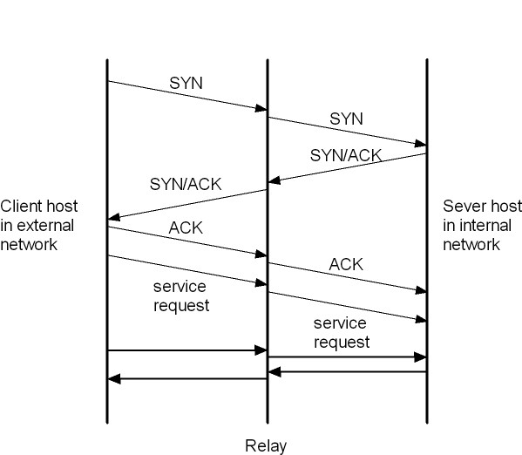
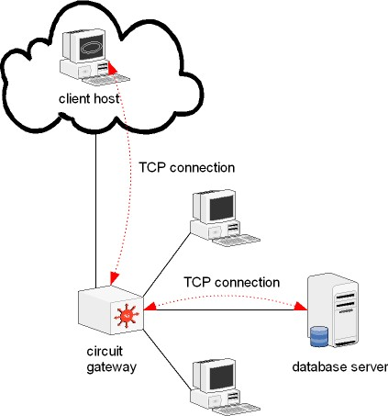
Examples

Slide 18
Circuit Gateways
Can encrypted packet be relayed through a circuit gateway?
Notes:
Circuit Gateways
The circuit gateway firewall operates at the transport layer.
Connections are authorized based on addresses.
Like filtering firewalls, circuit gateway firewalls do not usually look at data traffic flowing between one network and another, but they do prevent direct connections between one network and another.
They accomplish this by creating tunnels connecting specific processes or systems on each side of the firewall, and then allow only authorized traffic, such as a specific type of TCP connection for only authorized users, in these tunnels.

Slide 19
MAC Layer Firewalls
Designed to operate at the media access control layer of OSI network model
Able to consider specific host computer’s identity in its filtering decisions
MAC addresses of specific host computers are linked to access control list (ACL) entries that identify specific types of packets that can be sent to each host; all other traffic is blocked
Notes:
MAC Layer Firewalls
While not as well known or widely referenced as the firewall approaches above, MAC layer firewalls are designed to operate at the media access control layer of the OSI network model.
This gives these firewalls the ability to consider the specific host computer’s identity in its filtering decisions.
Using this approach, the MAC addresses of specific host computers are linked to ACL entries that identify the specific types of packets that can be sent to each host, and all other traffic is blocked.

Slide 20
Hybrid Firewalls
Combine elements of other types of firewalls; i.e., elements of packet filtering and proxy services, or of packet filtering and circuit gateways
Actually consists of two separate firewall devices; each is a separate firewall system, but they are connected so that they work in tandem.
An added advantage to the hybrid firewall approach is that it enables an organization to make a security improvement without completely replacing its existing firewalls
Notes:
Hybrid Firewalls
Hybrid firewalls combine the elements of other types of firewalls—that is, the elements of packet filtering and proxy services, or of packet filtering and circuit gateways.
Alternately, a hybrid firewall system may actually consist of two separate firewall devices; each is a separate firewall system, but they are connected so that they work in tandem.

Slide 21
First Generation Firewalls
The first generation of firewall are called Packet Filtering Firewalls, because they are simple networking devices that filter packets based on their header as they travel to and from the organization’s networks.
Firewall Examines every incoming packet header and can selectively filter packet (accept or reject) based on the these and other factors:
  Address
  Packet type
  Port Request (HTTP or Telnet)
The restrictions most commonly implemented are based on:
  IP source and destination address
  Direction (inbound or outbound)
  TCP or UDP source and destination port-requests
Notes:
First generation firewalls are static packet filtering firewalls and filter packets according to their headers as the packets travel to and from the organization’s networks.
Second generation firewalls are application-level firewalls or proxy servers — dedicated systems that are separate from the filtering router and that provide intermediate services for requestors.
Third generation firewalls are stateful inspection firewalls, and monitor network connections between internal and external systems using state tables.
Fourth generation firewalls are dynamic packet filtering firewalls and allow only a particular packet with a particular source, destination, and port address to enter.
Fifth generation firewalls are kernel proxy and are a specialized form that works under the Windows NT Executive, which is the kernel of Windows NT.

Slide 22
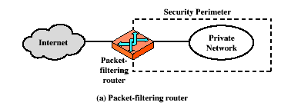
Firewalls – Packet Filters

Slide 23
First Generation Firewall Contd.
  First generation firewalls scan network data packets looking for compliance with or violation of the rules of the firewall’s database.
  First generation firewall inspect packets at the network layer or layer 3 of the OSI model. If it finds the packet that matches a restriction, it simply refuses to forward it from one network to another network.
  Early firewall models examines one aspect of the packet header: the destination address and source address. The force Address Restriction, rules designed to prohibit packets with certain address or partial address from passing through devices. It is accomplished through Access Control List (ACL) created and modified by the firewall administrator.
Notes:
First generation firewalls are static packet filtering firewalls and filter packets according to their headers as the packets travel to and from the organization’s networks.
Second generation firewalls are application-level firewalls or proxy servers — dedicated systems that are separate from the filtering router and that provide intermediate services for requestors.
Third generation firewalls are stateful inspection firewalls, and monitor network connections between internal and external systems using state tables.
Fourth generation firewalls are dynamic packet filtering firewalls and allow only a particular packet with a particular source, destination, and port address to enter.
Fifth generation firewalls are kernel proxy and are a specialized form that works under the Windows NT Executive, which is the kernel of Windows NT.

Slide 24
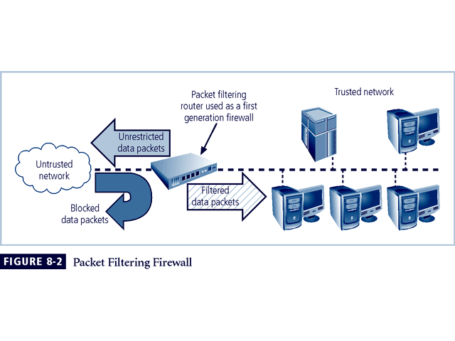
First Generation Firewall Contd.
Figure shows how a packet filtering router can be deployed as a simple firewall to filter data packet from inbound connection and allow outbound connections unrestricted access to the public network.
Notes:
First Generation
The first generation of firewalls are called packet filtering firewalls, because they are simple networking devices that filter packets based on their headers as they travel to and from the organization’s networks.
In this case the firewall examines every incoming packet header and it can selectively filter packets (accepting or rejecting as needed) based on:
address,
packet type,
port request and
others factors.
These devices scan network data packets looking for compliance with or violation of rules configured into the firewall’s database.
If a first generation firewall finds a packet that matches a restriction, it simply refuses to forward it.
The restrictions most commonly implemented are based on:
IP source and destination address
Direction (inbound or outbound)
Transmission Control Protocol (TCP) or User Datagram Protocol (UDP) source and destination port-requests
Early firewall models examine one aspect of the packet header: the destination and source address.
They enforce address restrictions, rules designed to prohibit packets with certain addresses or partial addresses, from passing through the device.
They accomplish this through access control lists (ACLs), created and modified by the firewall administrators.
The ability to restrict a specific service is now considered standard in most modern routers, and is invisible to the user.
Unfortunately these systems are unable to detect if packet headers have been modified, as occurs from IP spoofing attacks.

Slide 25
Attacks on Packet Filters
IP address Spoofing
  fake source address to be trusted
  add filters on router to block
Source Routing Attacks
The source routing specifies the route that a packet should take as it crosess the internet, in the hope that this will bypass security measure that do not analyze the source routing information. The countermeasure is to discard all the packet that use this option.
Tiny Fragment Attacks
  split header info over several tiny packets
  either discard or reassemble before check

Slide 26
Second Generation Firewall
Called application-level firewall or proxy server
Often a dedicated computer separate from the filtering router
With this configuration the proxy server, rather than the Web server, is exposed to the outside world in the DMZ
Additional filtering routers can be implemented behind the proxy server
The primary disadvantage of application-level firewalls is that they are designed for a specific protocol and cannot easily be reconfigured to protect against attacks on protocols for which they are not designed
Notes:
Second Generation
The next generation of firewalls is called the application-level firewall.
The application firewall is frequently a dedicated computer separate from the filtering router and quite commonly used in conjunction with a filtering router.
The application firewall is also known as a proxy server, since it runs special software designed to serve as a proxy for a service request.
With this configuration the proxy server, rather than the Web server is exposed to the outside world, in the DMZ.
A demilitarized zone (DMZ) is an intermediate area between a trusted network and an un-trusted network.
Additional filtering routers can be implemented behind the proxy server restricting the access of internal systems to the proxy server alone, thus further protecting internal systems.
The primary disadvantage of application-level firewalls is that they are designed for a specific protocol and cannot easily be reconfigured to protect against attacks on protocols for which they are not designed.

Slide 27
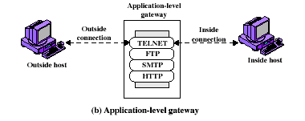
Firewalls - Application Level Gateway (or Proxy)

Slide 28
Third Generation Firewall
Called stateful inspection firewalls
Keeps track of each network connection established between internal and external systems using a state table which tracks the state and context of each packet in the conversation by recording which station sent what packet and when
If the stateful firewall receives an incoming packet that it cannot match in its state table, then it defaults to its ACL to determine whether to allow the packet to pass
The primary disadvantage is the additional processing requirements of managing and verifying packets against the state table which can possibly expose the system to a DoS attack
These firewalls can track connectionless packet traffic such as UDP and Remote Procedure Calls (RPC) traffic
Notes:
Third Generation
The next generation of firewalls, stateful inspection firewalls, keeps track of each network connection established between internal and external systems using a state table.
These state tables track the state and context of each packet in the conversation, by recording which station sent what packet and when.
Like first generation firewalls, stateful inspection firewalls perform packet filtering, but they take it a step further.
Whereas simple packet filtering firewalls only allow or deny certain packets based on their address, a stateful firewall can restrict incoming packets by denying access to packets that are responses to internal requests.
If the stateful firewall receives an incoming packet that it cannot match in its state table, then it defaults to its ACL to determine whether to allow the packet to pass.
The primary disadvantage of this type of firewall is the additional processing requirements of managing and verifying packets against the state table.
This can possibly expose the system to a DoS attack. In such an attack, the firewall can be subjected to a large number of external packets, slowing it down as it attempts to compare all of the incoming packets first to the state table and then to the ACL.
On the positive side, these firewalls can track connectionless packet traffic such as UDP and remote procedure calls (RPC) traffic.

Slide 29
Firewalls – Stateful Packet Filters
examine each IP packet in context
  keeps tracks of client-server sessions
  checks each packet validly belongs to one
better able to detect bogus packets out of context

Slide 30
Fourth Generation Firewall
While static filtering firewalls, such as first and third generation, allow entire sets of one type of packet to enter in response to authorized requests, a dynamic packet filtering firewall allows only a particular packet with a particular source, destination, and port address to enter through the firewall
It does this by understanding how the protocol functions, and opening and closing “doors” in the firewall, based on the information contained in the packet header. In this manner, dynamic packet filters are an intermediate form, between traditional static packet filters and application proxies
Notes:
Fourth Generation
While static filtering firewalls, such as first and third generation, allow entire sets of one type of packet to enter in response to authorized requests, a dynamic packet filtering firewall allows only a particular packet with a particular source, destination and port address to enter through the firewall.
It does this by understanding how the protocol functions, and opening and closing “doors” in the firewall, based on the information contained in the packet header. In this manner, dynamic packet filters are an intermediate form, between traditional static packet filters and application proxies.

Slide 31
Fifth Generation
The final form of firewall is the kernel proxy, a specialized form that works under the Windows NT Executive, which is the kernel of Windows NT
It evaluates packets at multiple layers of the protocol stack, by checking security in the kernel as data is passed up and down the stack
Notes:
Fifth Generation
The final form of firewall is the kernel proxy, a specialized form that works under the Windows NT Executive, which is the kernel of Windows NT.
It evaluates packets at multiple layers of the protocol stack, by checking security in the kernel as data is passed up and down the stack.

Slide 32
Firewalls Categorized by Architectural Implementation
Firewall devices can be configured in a number of network connection architectures
Four common architectural implementations of firewalls:
  Packet filtering routers
  Screened host firewalls
  Dual-homed firewalls
  Screened subnet firewalls
Notes:
Firewall Architectures
Each of the firewall devices noted earlier can be configured in a number of network connection architectures.
The firewall configuration that works best for a particular organization depends on three factors: the objectives of the network, the organization’s ability to develop and implement the architectures, and the budget available for the function.
Although literally hundreds of variations exist, there are four common architectural implementations of firewalls:
packet filtering routers,
screened host firewalls,
dual-homed firewalls, and
screened subnet firewalls.
Packet Filtering Routers
Most organizations with an Internet connection have a router as the interface to the Internet at the perimeter. Many of these routers can be configured to reject packets that the organization does not allow into the network.
The drawbacks to this type of system include a lack of auditing and strong authentication and the complexity of the access control lists used to filter the packets can grow and degrade network performance.

Slide 33
Bastion Hosts
Bastion hosts are computers with strong defensive mechanisms.
They often serve as host computers for implementing Application Gateway, Circuit Gateway, and other types of firewall.
Bastion hosts is operated on a trusted operating system that must not contain unnecessary functionalities or program. This measure helps to reduce error probabilities and makes its easier to conduct security checks.
Only application program that are absolutely necessary e.g., SSH, DNS, SMTP and authentication program are installed on the bastion host.

Slide 34
Requirements
Gateway software should be written using only small modules
May provide user authentication at the network level
Should be connected to the smallest possible number of internal hosts
Extensive logs should be kept of all activity passing through the system
If they are running on a single host, multiple gateways must operate independently
Hosts should avoid writing data to their hard disks
Gateways running on bastion hosts should not be given administration rights

Slide 35
Firewall Configuration
Gateway running on a bastion host are often used with packet filters. Without loss of generality, assume that router has build-in packet filter.
For the sake of convenience, use bastion host to represent a proxy server where bastion host may run several proxy servers simultaneously and independently.
Several common firewall configuration
  Single-Homed Bastion Host System (SHBH)
  Dual-Homed Bastion Host System (DHBH)
  Screened Subnets

Slide 36
Packet Filtering Routers
Most organizations with Internet connection have a router serving as interface to Internet
Many of these routers can be configured to reject packets that organization does not allow into network
Drawbacks include a lack of auditing and strong authentication
Notes:
Packet Filtering Routers
Most organizations with an Internet connection have a router as the interface to the Internet at the perimeter. Many of these routers can be configured to reject packets that the organization does not allow into the network.
The drawbacks to this type of system include a lack of auditing and strong authentication and the complexity of the access control lists used to filter the packets can grow and degrade network performance.

Slide 37
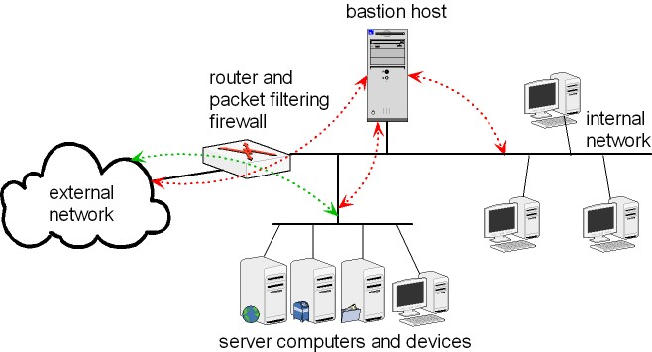
Single-Homed Bastion Host System
A single-homed bastion host system consists of a packet filtering router and bastion host, where the router connects the internal network to external network and the bastion host is inside the internal network.
The router announces to the public the IP address and the port numbers of internal server computers.
Router does not forward the ingress packets directly to server computers. Instead, the router inspects an ingress packet. If the packet passes the inspection, the router passes it to the bastion host.

Slide 38
Single-Homed Bastion Host System
In an SHBH system, if an attacker compromises the packet filtering router, attacker can modify ACL rules to bypass the bastion host. That is, malice could modify the ACL rules to forward packets directly to internal hosts, making the bastion host becomes nothing but an ornament. This problem can be solved using a dual-homed bastion host.

Slide 39
Dual-Homed Bastion Host System
Bastion host contains two network interface cards (NICs): one connected to external network, one connected to internal network
Implementation of this architecture often makes use of network address translation (NAT), creating another barrier to intrusion from external attackers
Notes:
Dual-Homed Host Firewalls
With this approach the bastion host contains two NICs: one connected to the external network, and one connected to the internal network, providing an additional layer of protection by requiring all traffic to go through the firewall to move between the internal and external networks.
Implementation of this architecture often makes use of NAT - mapping assigned IP addresses to special ranges of non-routable internal IP addresses, creating yet another barrier to intrusion from external attackers.

Slide 40
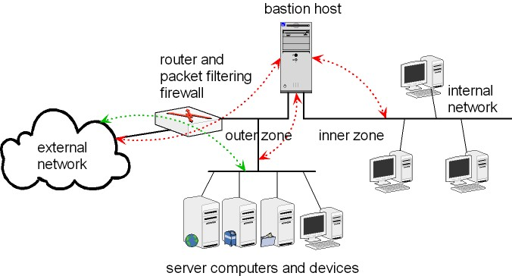
Dual-Homed Bastion Host System
A dual-homed bastion host network divides the internal network into two zones. These two zones are referred to as the inner zone and the outer zone. The inner zone is also referred to as the private zone.
The IP address of the host computer in the private zone are not reachable from the external network. The IP addresses of the host computers in the outer zone may be directly reachable from the Internet.
In particular, the router is placed between the external network and the outer zone, and between the external network and the bastion host.

Slide 41
Dual-Homed Bastion Host System Contd.
Unlike, the SHBH, the inner zone in DHBH is connected to the bastion host only. Thus, host computers inner zone are protected by both the bastion host and the packet filtering router.
Similar to SHBH system, a DHBH allows the server computers in the outer zone to communicate to the internet without going through the bastion host. In other words, the ACL in the router allows each inbound packet to pass through its source address is allowed and destination IP address and port number match with the IP address of a server computer and an open port of the server.

Slide 42
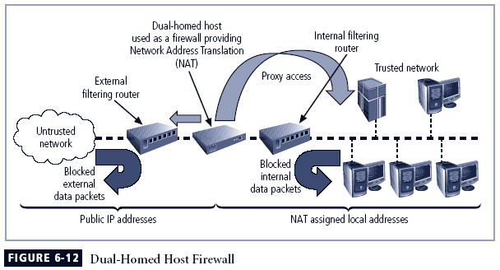
Dual-Homed Bastion Host System Contd.

Slide 43
Demilitarized Zones (DMZ)
A subnet between two firewalls in an internal network is often referred as a Demilitarized Zone (DMZ).
The external firewall protects the DMZ subnetwork from external networks and the internal firewall protects the internal network from the DMZ.
DMZ subnetwork may or not have a bastion host.
Server computers and devices that do not require strong security protections are placed in the DMZ subnetwork so that they will not be exposed to the external networks without any security protection.
The concept of single-layer DMZ can be generalized to a multiple-layer DMZ where a DMZ may also contain a sub-DMZ.
Computers needing the most security protections are placed in a subnetwork that is connected to innermost firewall.
Computers needing the least security protections are placed in the outermost DMZ, which is protected only by the outermost firewall.

Slide 44
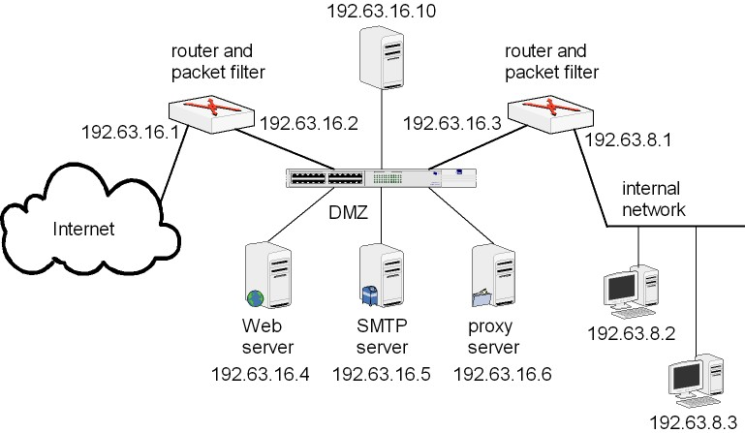
Demilitarized Zones (DMZ) Contd.

Slide 45
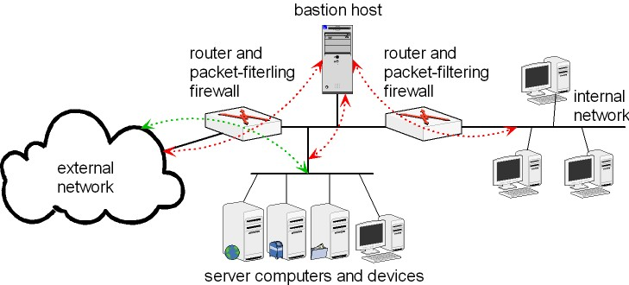
Screened Subnets
Screened subnets are the most secure firewall configuration. A screened subnet consists of a bastion host and two packet filtering routers.
Screened subnet is a SHBH network with a second packet filtering router (i.e., inner router) inserted between the bastion host and the internal network . That is, in a screened subnet, one router is placed between the Internet and the bastion host, and the other router is placed between the bastion host and the internal network.

Slide 46
Screened Subnets Contd.
The two packet-filtering firewalls create an isolated, screened sub-network in between.
The outer routers announces to the public IP addresses and port numbers of the server computers and devices connected to the screened sub-network.
The inner router announces to the internal network the IP addresses and port numbers of the server computers and devices connected to the screened sub-network. Thus, the structure of the internal network is hidden from the outside world.
The internal hosts can only communicate with external hosts through server computers or devices in the screened sub-network.
Notes:
Screened Host Firewalls
This architecture combines the packet filtering router with a separate, dedicated firewall, such as an application proxy server, allowing the router to prescreen packets to minimize the network traffic and load on the internal proxy.
The application proxy examines an application layer protocol and performs the proxy services.
This separate host is often referred to as a bastion host or sacrificial host; it can be a rich target for external attacks, and should be very thoroughly secured.

Slide 47
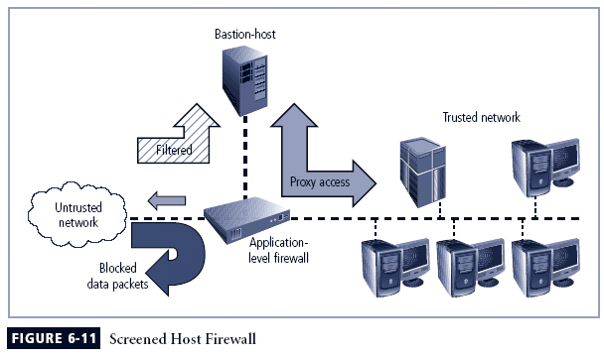
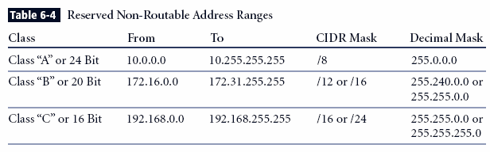
Screened Subnets Contd.

Slide 48
Screened Subnet Firewalls (with DMZ)
Dominant architecture used today is the screened subnet firewall
Commonly consists of two or more internal bastion hosts behind packet filtering router, with each host protecting trusted network:
  Connections from outside (untrusted network) routed through external filtering router
  Connections from outside (untrusted network) are routed into and out of routing firewall to separate network segment known as DMZ
  Connections into trusted internal network allowed only from DMZ bastion host servers.
  Screened subnet performs two functions:
  Protects DMZ systems and information from outside threats
  Protects the internal networks by limiting how external connections can gain access to internal systems
Another facet of DMZs: extranets
Notes:
Screened Subnet Firewalls (with DMZ)
The dominant architecture used today, the screened subnet firewall provides a DMZ, which could be a dedicated port on the firewall device linking a single bastion host, or it can be connected to a screened subnet.
A common arrangement finds the subnet firewall consisting of two or more internal bastion hosts behind a packet filtering router, with each host protecting the trusted network:
Connections from the outside or untrusted network are routed through an external filtering router.
Connections from the outside or untrusted network are routed into—and then out of—a routing firewall to the separate network segment known as the DMZ.
Connections into the trusted internal network are allowed only from the DMZ bastion host servers.
The screened subnet is an entire network segment that performs two functions:
it protects the DMZ systems and information from outside threats by providing a network of intermediate security; and
it protects the internal networks by limiting how external connections can gain access to internal systems.
DMZs can also create extranets - segments of the DMZ where additional authentication and authorization controls are put into place to provide services that are not available to the general public.

Slide 49
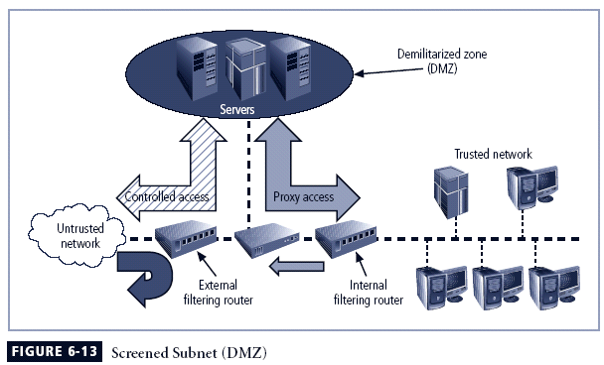
Screened Subnet Firewalls (with DMZ)

Slide 50
SOCKS
  SOCKS (shorts for sockets)
  SOCKS is a network protocol for implementing circuit gateway.
  SOCKS consists of three components: the SOCKS server, SOCKS client and SOCKS client library.
  SOCKS server runs on packet filtering firewall through port 1080. SOCKS client library runs on an internal hosts and SOCKS client runs on an external host.
  SOCKS client executes on the modified version of FTP and other standard TCP-based client application programs which are modified version for SOCKS.
  When an external client wants to obtain service from an internal server under protection of SOCKS, the client must first establish a TCP connection with the SOCK server. It negotiates with the SOCKS server to select an authentication algorithm, provides information for authentication and submits a relay request .
  SOCKS server verifies the information submitted for authentication and determines whether to establish a relay connection with the internal server as requested.
Notes:
Screened Subnet Firewalls (with DMZ)
The dominant architecture used today, the screened subnet firewall provides a DMZ, which could be a dedicated port on the firewall device linking a single bastion host, or it can be connected to a screened subnet.
A common arrangement finds the subnet firewall consisting of two or more internal bastion hosts behind a packet filtering router, with each host protecting the trusted network:
Connections from the outside or untrusted network are routed through an external filtering router.
Connections from the outside or untrusted network are routed into—and then out of—a routing firewall to the separate network segment known as the DMZ.
Connections into the trusted internal network are allowed only from the DMZ bastion host servers.
The screened subnet is an entire network segment that performs two functions:
it protects the DMZ systems and information from outside threats by providing a network of intermediate security; and
it protects the internal networks by limiting how external connections can gain access to internal systems.
DMZs can also create extranets - segments of the DMZ where additional authentication and authorization controls are put into place to provide services that are not available to the general public.

Slide 51
SOCKS Contd.
  Only after the client request is granted should the client be allowed to forward the UDP packet to the internal host using the SOCKS server as a relay node. This packet is forwarded through TCP connection which is established between the SOCKS server and client.
Notes:
Screened Subnet Firewalls (with DMZ)
The dominant architecture used today, the screened subnet firewall provides a DMZ, which could be a dedicated port on the firewall device linking a single bastion host, or it can be connected to a screened subnet.
A common arrangement finds the subnet firewall consisting of two or more internal bastion hosts behind a packet filtering router, with each host protecting the trusted network:
Connections from the outside or untrusted network are routed through an external filtering router.
Connections from the outside or untrusted network are routed into—and then out of—a routing firewall to the separate network segment known as the DMZ.
Connections into the trusted internal network are allowed only from the DMZ bastion host servers.
The screened subnet is an entire network segment that performs two functions:
it protects the DMZ systems and information from outside threats by providing a network of intermediate security; and
it protects the internal networks by limiting how external connections can gain access to internal systems.
DMZs can also create extranets - segments of the DMZ where additional authentication and authorization controls are put into place to provide services that are not available to the general public.

Slide 52
Selecting the Right Firewall
When selecting firewall, consider a number of factors:
  What firewall offers right balance between protection and cost for needs of organization?
  What features are included in base price ? What features are available at extra cost? Are all the factors known?
  How easy to setup and configuration the firewall? How accessible are staff technicians who can configure the firewall?
  Can the candidate firewall adapt to the growing network in the target organization?
Second most important factor is cost. Cost may keep a certain make or type out of reach. As with all security decision, certain compromises may be necessary in order to provide a possible solution under the budgetary constraints stipulated by management.
Notes:
Selecting the Right Firewall
When selecting the best firewall for an organization, you should consider a number of factors. The most important of these is the extent to which the firewall design provides the desired protection:
What type of firewall technology offers the right balance between protection and cost for the needs of the organization?
What features are included in the base price? What features are available at extra cost? Are all cost factors known?
How easy is it to set up and configure the firewall? How accessible are the staff technicians who can competently configure the firewall?
Can the candidate firewall adapt to the growing network in the target organization?
The second most important issue is cost.

Slide 53
Best Practices for Firewalls
All traffic from trusted network is allowed out. This allows the members of the organization to access the service they need. Filtering and logging of outbound traffic can be implemented when required by specific organizational policies.
Firewall device is never directly accessed from public network for configuration or management purpose. Almost all administrative access to the firewall device is denied to internal users as well. Only authorized firewall administrators access the device through secure authentication mechanism, preferable via a method that is based on cryptographically strong authentication and uses two-factor access control technique.
Simple Mail Transport Protocol (SMTP) data allowed to enter through the firewall, but it is routed to a well configured SMTP gateway to filter and route messaging traffic securely.
All Internet Control Message Protocol (ICMP) data should be denied. Know an as the ping service, ICMP is a common method for hacker to reconnaissance and should be turned off to prevent snooping.
Notes:
Best Practices for Firewalls
All traffic from the trusted network is allowed out.
The firewall device is never directly accessible from the public network.
SMTP data is allowed to pass through the firewall, but should be routed to a well-configured SMTP gateway to filter and route messaging traffic securely.
All ICMP data should be denied.
Telnet access to all internal servers from the public networks should be blocked.
When Web services are offered outside the firewall, HTTP traffic should be denied from reaching your internal networks through the use of some form of proxy access or DMZ architecture.

Slide 54
Best Practices for Firewalls Contd.
When Web services are offered outside the firewall , HTTP traffic should be blocked from your internal networks through the use of some from of proxy access or DMZ architecture. That way, if any employees are running Web servers for internal use on their desktops, the service are invisible to the outside Internet at large to view it. The best solution is to place the Web servers containing critical data inside the network and use proxy services from DMZ (screened network management) and also to restrict Web traffic bound for internal network address to allow only those request that originated from internal address
All data is not verifiably authentic should be denied. When attempting to convince packet filtering firewall to permit malicious traffic, attacker will frequently put an internal address in the source filed. To avoid this problem, set rules so that the external firewall blocks all inbound traffic with an organizational source address.
Notes:
Best Practices for Firewalls
All traffic from the trusted network is allowed out.
The firewall device is never directly accessible from the public network.
SMTP data is allowed to pass through the firewall, but should be routed to a well-configured SMTP gateway to filter and route messaging traffic securely.
All ICMP data should be denied.
Telnet access to all internal servers from the public networks should be blocked.
When Web services are offered outside the firewall, HTTP traffic should be denied from reaching your internal networks through the use of some form of proxy access or DMZ architecture.

Slide 55
Firewall Rules
Operate by examining data packets and performing comparison with predetermined logical rules
Logic based on set of guidelines most commonly referred to as firewall rules, rule base, or firewall logic
Most firewalls use packet header information to determine whether specific packet should be allowed or denied.
Some firewalls can filer packets protocol name as opposed to protocol port number. For, instance, Telnet protocol packets usually go to TCP port 23, but can sometimes be redirected to another much higher port number in an attempt to conceal the activity.
The system (or well known ) ports are those from ‘0’ to 1023, User (or Registered) ports are those from 1024 to 49151, and dynamic (or Private) ports are those from 59152 to 65535
Notes:
Firewall Rules
Firewalls operate by examining a data packet and performing a comparison with some predetermined logical rules.
This logical set is most commonly referred to as firewall rules, rule base, or firewall logic.
Most firewalls use packet header information to determine whether a specific packet should be allowed to pass through or should be dropped.

Slide 56
Standard Port Numbers
Simple TCP/IP services usually listen on the following ports
Port TCP/IP Service
7 Echo (Ping)
9 Discard
13 Daytime
17 Quote of the day
19 Character Generator
Notes:
Firewall Rules
Firewalls operate by examining a data packet and performing a comparison with some predetermined logical rules.
This logical set is most commonly referred to as firewall rules, rule base, or firewall logic.
Most firewalls use packet header information to determine whether a specific packet should be allowed to pass through or should be dropped.

Slide 57
Standard Port Numbers
Internet server usually listen on the following ports
Port Server
21 File Transfer Protocol
23 Telnet
70 Gopher
80 World Wide Web
119 Net News (NNTP)
22 Secure Shell
443 Secure HTTP (HTTPS)
Notes:
Firewall Rules
Firewalls operate by examining a data packet and performing a comparison with some predetermined logical rules.
This logical set is most commonly referred to as firewall rules, rule base, or firewall logic.
Most firewalls use packet header information to determine whether a specific packet should be allowed to pass through or should be dropped.

Slide 58
Packet Filtering Rules
The packet filter is typically setup as a list of rules based on matches to files in the IP or TCP header. If there is match to one of the rules, that rule is invoked to determine whether to forward to discard the packet. If there is not match to any rule, then default action is taken. Two default policies are possible.
Default = discard : That which is not expressly permitted to prohibited.
Default = Forward : That which is not expressly prohibited is permitted.
Default discard policy is more conservative. Initially, everything is blocked, and service must be added on a case by case. This policy is more visible to users, who are more likely to see the firewall as a hindrance.
The default forward policy is increases case of use for end user but provides reduced security; the security administrator must in essence, react
to each new security threat as it become know.
Notes:
Best Practices for Firewalls
All traffic from the trusted network is allowed out.
The firewall device is never directly accessible from the public network.
SMTP data is allowed to pass through the firewall, but should be routed to a well-configured SMTP gateway to filter and route messaging traffic securely.
All ICMP data should be denied.
Telnet access to all internal servers from the public networks should be blocked.
When Web services are offered outside the firewall, HTTP traffic should be denied from reaching your internal networks through the use of some form of proxy access or DMZ architecture.

Slide 59
Packet Filtering Rules
The packet filter is typically setup as a list of rules based on matches to files in the IP or TCP header. If there is match to one of the rules, that rule is invoked to determine whether to forward to discard the packet. If there is not match to any rule, then default action is taken. Two default policies are possible.
Default = discard : That which is not expressly permitted is prohibited.
Default = Forward : That which is not expressly prohibited is permitted.
Default discard policy is more conservative. Initially, everything is blocked, and service must be added on a case by case. This policy is more visible to users, who are more likely to see the firewall as a hindrance.
The default forward policy is increases case of use for end user but provides reduced security; the security administrator must in essence, react
to each new security threat as it become know.
Notes:
Best Practices for Firewalls
All traffic from the trusted network is allowed out.
The firewall device is never directly accessible from the public network.
SMTP data is allowed to pass through the firewall, but should be routed to a well-configured SMTP gateway to filter and route messaging traffic securely.
All ICMP data should be denied.
Telnet access to all internal servers from the public networks should be blocked.
When Web services are offered outside the firewall, HTTP traffic should be denied from reaching your internal networks through the use of some form of proxy access or DMZ architecture.

Slide 60
Packet Filtering Rules
Assume that default = ‘discard’ policy in force.
Inbound mail is allowed (port 25 is for SMTP incoming , but only to gateway host. However, packets from a particular external host, SPIGOT are blocked because that host has a history of sending massive file in e-mail message.
This rule is intended to specify that any inside host can send mail to the outside. A TCP packet with a destination port of 25 is routed to the SMTP server on the destination machine. The problem with this rule is that the use of port 25 for SMTP receipt is only a default; an outside machine could be configured to have some other application linked to port 25. As this rule is written, an attacker could gain access to internal machines by sending packets with a TCP source port number of 25
Notes:
Best Practices for Firewalls
All traffic from the trusted network is allowed out.
The firewall device is never directly accessible from the public network.
SMTP data is allowed to pass through the firewall, but should be routed to a well-configured SMTP gateway to filter and route messaging traffic securely.
All ICMP data should be denied.
Telnet access to all internal servers from the public networks should be blocked.
When Web services are offered outside the firewall, HTTP traffic should be denied from reaching your internal networks through the use of some form of proxy access or DMZ architecture.

Slide 61
Packet Filtering Rules Contd.
Assume that default = ‘discard’ policy in force.
This rule set achieves the intended result that was not achieved in previous rule. The rules take advantage of a feature of TCP connections. Once a connection is setup, the ACK flag of TCP segment is set to acknowledge segments sent from the other side. Thus, this rule set states that it allow IP packets where the source IP address is one of the list of designated internal host and the destination TCP port number is 25. It also allows incoming packets with a source port number of 25 that includes ACK flag in TCP segment.
This rule set is one approach to handling FTP connections. With FTP, two TCP connections are used. With FTP, two TCP connections are used: a control connection is set up the file transfer and a data connection for the actual file transfer. The data connection uses a different port number that is dynamically assigned for the transfer.
Notes:
Best Practices for Firewalls
All traffic from the trusted network is allowed out.
The firewall device is never directly accessible from the public network.
SMTP data is allowed to pass through the firewall, but should be routed to a well-configured SMTP gateway to filter and route messaging traffic securely.
All ICMP data should be denied.
Telnet access to all internal servers from the public networks should be blocked.
When Web services are offered outside the firewall, HTTP traffic should be denied from reaching your internal networks through the use of some form of proxy access or DMZ architecture.

Slide 62
Packet Filtering Rules Contd.
This rule set is one approach to handling FTP connections. With FTP, two TCP connections are used. With FTP, two TCP connections are used: a control connection is set up the file transfer and a data connection for the actual file transfer. The data connection uses a different port number that is dynamically assigned for the transfer.
Action | Source | Port | Destination | Port | Flags | Comments
Allow | {Our Hosts} | * | * | * |  | Our Outgoing Calls
Allow | * | * | * | * | ACK | Replies to our calls
Allow | * | * | * | >1024 |  | Traffic to non servers
Notes:
Best Practices for Firewalls
All traffic from the trusted network is allowed out.
The firewall device is never directly accessible from the public network.
SMTP data is allowed to pass through the firewall, but should be routed to a well-configured SMTP gateway to filter and route messaging traffic securely.
All ICMP data should be denied.
Telnet access to all internal servers from the public networks should be blocked.
When Web services are offered outside the firewall, HTTP traffic should be denied from reaching your internal networks through the use of some form of proxy access or DMZ architecture.

Slide 63
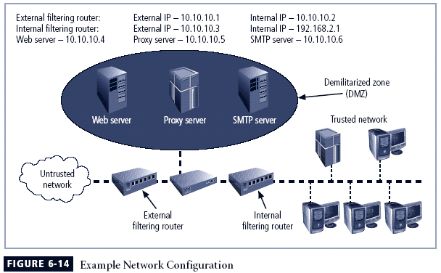
Rule Set 1
Response to internal requests are allowed. In most firewall implementation it is desirable to allow a response to an internal request for information. In dynamic or stateful, this is most easily accomplished by matching the incoming traffic to an outgoing request in a state table. In simple packe filtering, this can be accomplished with the f
Source Address | Port | Destination Address | Port | Action
Any | Any | 10.10.10.0 | >1024 | Allow
Notes:
Firewall Rules
Firewalls operate by examining a data packet and performing a comparison with some predetermined logical rules.
This logical set is most commonly referred to as firewall rules, rule base, or firewall logic.
Most firewalls use packet header information to determine whether a specific packet should be allowed to pass through or should be dropped.

Slide 64
Rule Set 2
Firewall device is never accessible directly from the public network. If attacker can directly access the firewall , they may be able to modify or delete rules and allow unwanted traffic through.
Source Address | Port | Destination Address | Port | Action
Any | Any | 10.10.10.1 | Any | Deny
Any | Any | 10.10.10.2 | Any | Deny
10.10.10.1 | Any | Any | Any | Deny
10.10.10.2 | Any | Any | Any | Deny
Notes:
Firewall Rules
Firewalls operate by examining a data packet and performing a comparison with some predetermined logical rules.
This logical set is most commonly referred to as firewall rules, rule base, or firewall logic.
Most firewalls use packet header information to determine whether a specific packet should be allowed to pass through or should be dropped.

Slide 65
Rule Set 3
All the traffic from the trusted network is allowed out. As a general rule it is wise not to restrict outbound traffic, unless a separate router is configured to handle it, to avoid overloading the firewall. If an organization wants control over outbound traffic, it should use a separate filtering device.
Source Address | Port | Destination Address | Port | Action
10.10.10.0 | Any | Any | any | Allow
Notes:
Firewall Rules
Firewalls operate by examining a data packet and performing a comparison with some predetermined logical rules.
This logical set is most commonly referred to as firewall rules, rule base, or firewall logic.
Most firewalls use packet header information to determine whether a specific packet should be allowed to pass through or should be dropped.

Slide 66
Rule Set 4
The rule set for Simple Mail Transport Protocol.
The packets governed by this rule are allowed to pass through the firewall, but are all routed to a well configured SMTP gateway. It is important that e-mail traffic reach your email traffic server and only your email server.
Source Address | Port | Destination Address | Port | Action
Any | Any | 10.10.10.6 | 25 | Allow
Notes:
Firewall Rules
Firewalls operate by examining a data packet and performing a comparison with some predetermined logical rules.
This logical set is most commonly referred to as firewall rules, rule base, or firewall logic.
Most firewalls use packet header information to determine whether a specific packet should be allowed to pass through or should be dropped.

Slide 67
Rule Set 5
All Internet Control Message Protocol (ICMP)data should be denied. Ping, formally known as ICMP echo request are used by internal system administrator to ensure that the clients and servers can communicate.
Source Address | Port | Destination Address | Port | Action
10.10.10.0 | Any | Any | 7 | Allow
Any | Any | 10.10.10.0 | 7 | Deny
Notes:
Firewall Rules
Firewalls operate by examining a data packet and performing a comparison with some predetermined logical rules.
This logical set is most commonly referred to as firewall rules, rule base, or firewall logic.
Most firewalls use packet header information to determine whether a specific packet should be allowed to pass through or should be dropped.

Slide 68
Rule Set 6
Telnet (Terminal emulation) access to all internal servers from the public networks should be blocked. Though not used much in windows environments. Telnet is still useful to system administrator on Unix/Linux system.
Source Address | Port | Destination Address | Port | Action
10.10.10.0 | Any | 10.10.10.0 | 23 | Allow
Any | Any | 10.10.10.0 | 23 | Deny
Notes:
Firewall Rules
Firewalls operate by examining a data packet and performing a comparison with some predetermined logical rules.
This logical set is most commonly referred to as firewall rules, rule base, or firewall logic.
Most firewalls use packet header information to determine whether a specific packet should be allowed to pass through or should be dropped.

Slide 69
Rule Set 7
When a web service are offered outside the firewall, HTTP traffic should be blocked from the internal network via the use of some form of proxy access or DMZ architecture.
With a Web server
Source Address | Port | Destination Address | Port | Action
Any | Any | 10.10.10.4 | 80 | Allow
Notes:
Firewall Rules
Firewalls operate by examining a data packet and performing a comparison with some predetermined logical rules.
This logical set is most commonly referred to as firewall rules, rule base, or firewall logic.
Most firewalls use packet header information to determine whether a specific packet should be allowed to pass through or should be dropped.

Slide 70
Rule Set 8
The Cleanup Rule As a general practice in firewall rule construction, if a request for a service is not explicitly allowed by policy, that request should be denied by a rule.
Additional rules restricting access to a specific servers or device can be added, but they must be sequenced before the cleanup
Source Address | Port | Destination Address | Port | Action
Any | Any | 10.10.10.4 | 80 | Allow
Notes:
Firewall Rules
Firewalls operate by examining a data packet and performing a comparison with some predetermined logical rules.
This logical set is most commonly referred to as firewall rules, rule base, or firewall logic.
Most firewalls use packet header information to determine whether a specific packet should be allowed to pass through or should be dropped.

Slide 71
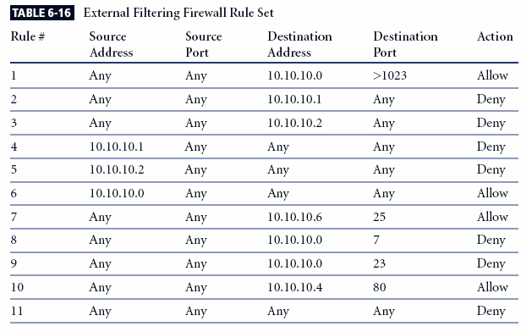
Notes:
(For Notes Page)
Note that the rule allowing responses to internal communications comes first (appearing in Table 6-16 as Rule #1), followed by the four rules prohibiting direct communications to or from the firewall (Rules #2-5 in Table 6-16). After this comes the rule stating that all outgoing internal communications are allowed, followed by the rules governing access to the SMTP server, and denial of Ping, Telnet access, and access to the HTTP server. If heavy traffic to the HTTP server is expected, move the HTTP server rule closer to the top (for example, into the position of Rule #2), which would expedite rule processing for external communications. The final rule in Table 6-16 denies any other types of communications.

Slide 72
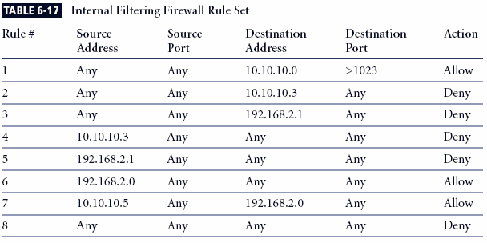
Notes:
(For Notes Page)
Note the similarities and differences in the two rule sets. The internal filtering router/firewall rule set, shown in Table 6-17, has to both protect against traffic to and allow traffic from the internal network (192.168.2.0). Most of the rules in Table 6-17 are similar to those in Table 6-16: allowing responses to internal communications (Rule #1); denying communications to/from the firewall itself (Rules #2-5); and allowing all outbound internal traffic (Rule #6). Note that there is no permissible traffic from the DMZ systems, except as in Rule #1. Why isn’t there a comparable rule for the 192.168.2.1 subnet? Because this is an unrouteable network, external communications are handled by the NAT server, which maps internal (192.168.2.0) addresses to external (10.10.10.0) addresses. This prevents a hacker from compromising one of the internal boxes and accessing the internal network with it. The exception is the proxy server (Rule #7 in Table 6-17), which should be very carefully configured. If the organization does not need the proxy server, as in cases where all externally accessible services are provided from machines in the DMZ, then Rule #7 is not needed. Note that there are no Ping and Telnet rules in Table 6-17. This is because the external firewall filters these external requests out. The last rule, Rule #8, provides cleanup.

Slide 73
Problem No. 3
In the above figure, assume that the router uses ACL rules given in table 7.7 and the inner router uses ACL rules given in Table 7.8. In addition to port 25, other ports in the tables are defined as follows: port 80 used for Web server program HTTP, port 7 is used for server program echo, port 23 is used for server program telnet and port 22 is used for server program SSH.
Explain what each ACL rule is intended to do
Point out which ACL rule is used for egress packet and which ACL rule is used for ingress packets.

Slide 74
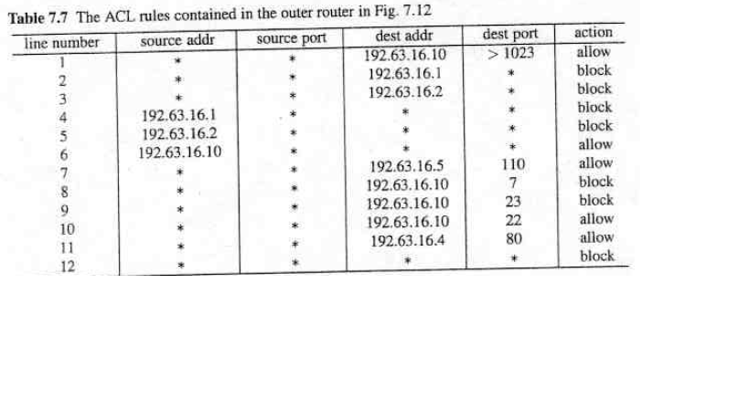

Slide 75
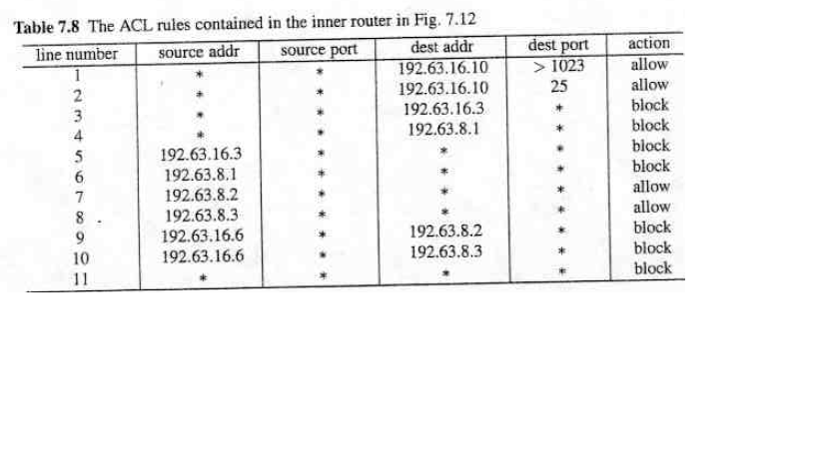

Slide 76
Problem No. 4
If an ingress packet from an external network to the internal network, its source address is an internal IP address or its private network address, should this packet be allowed or blocked? Why?

Slide 77
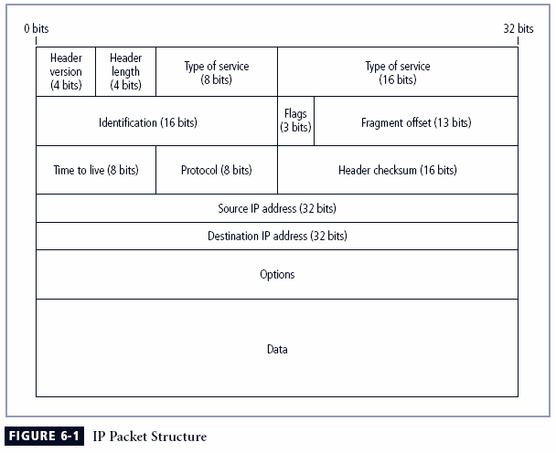
Packet Filters Contd.

Slide 78
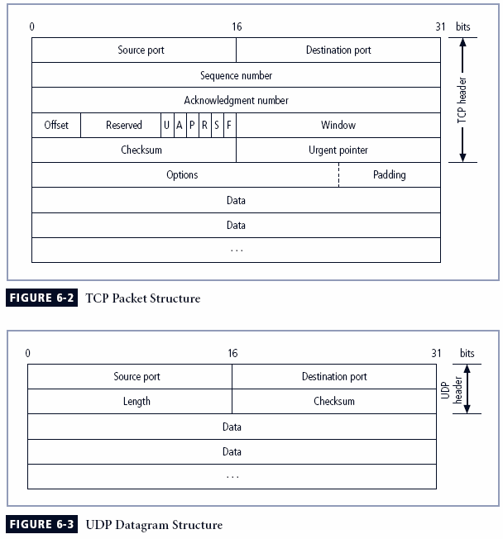
Packet Filters Contd.

Slide 79
IP Datagram Fragmentation
Start of header
Ident
= x
0
Offset
= 0
(a)
Rest of header
Identification is selected by sender host, and is unique for each packet sent by that host in recent past.
M bit: shows whether there are more fragments for that packet following
Offset: deals with possibly reordered fragments (counts 8-byte words; why not count bytes?)
A packet can be fragmented at multiple routers
Reassembly is only performed at the receiving host
When should receiver give up on the reassembly of a packet?
1400 data bytes
Start of header
Ident
= x
1
Offset
= 0
(b)
Rest of header
512 data bytes
Start of header
Ident
= x
1
Offset
= 64
Rest of header
512 data bytes
Start of header
Ident
= x
0
Offset
= 128
Rest of header
376 data bytes

Slide 80
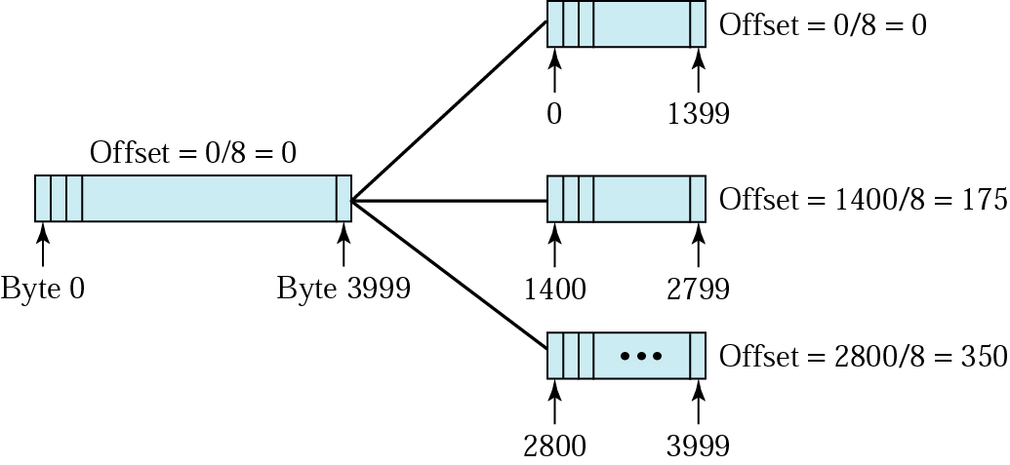
IP Fragmentation Example

Slide 81
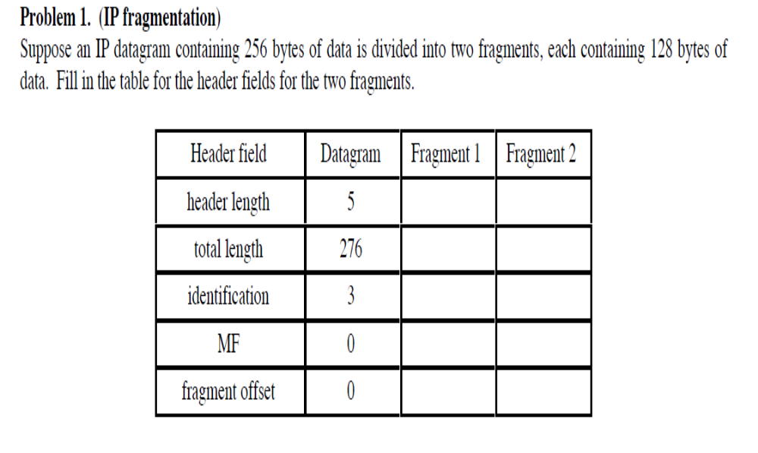
Problem No. 1

Slide 82
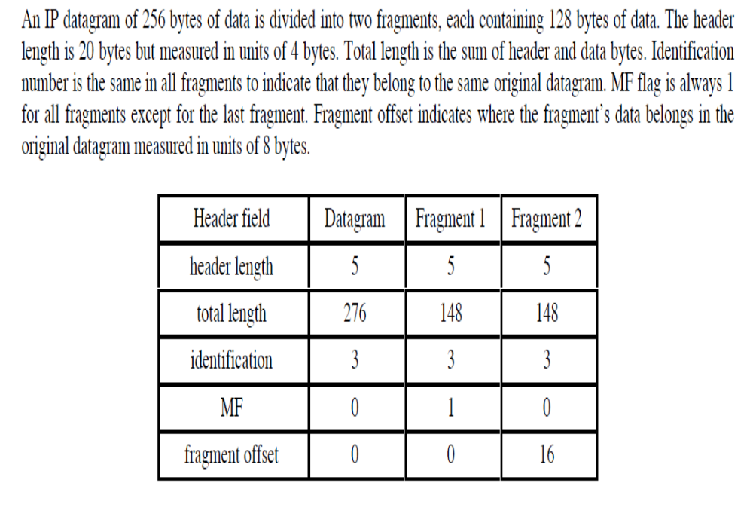
Solution to Problem No. 1

Slide 83
Problem No. 1
One approach to defeat the tiny fragment attack is to enforce a minimum length of the transport header that must contained in the first fragment of an IP packet. If the first fragment is rejected, all the subsequent fragment can be rejected. However, the nature of the IP is such that fragments may arrive out of order. Thus, an intermediate fragment may pass through the filter before the initial fragment is rejected. How can this situation be handled.

Slide 84
Answer to Problem No. 1
It will be impossible for the destination host to complete reassembly of the packet if the first fragment is missing, and therefore the entire packet will be discarded by the destination after a time-out.

Slide 85
Problem No. 2
In an IPv4 packet, the size of the payload in the first fragment, in octet is equal to Total Length-(4*IHL). If this value is less than the required minimum (8 octets for TCP) then this fragment and the entire packet are rejected. Suggest an alternative method of achieving the same result using only the Fragment offset Field.

Slide 86
Solution to Problem No. 2
When a TCP packet is fragmented so as to force interesting header fields out of the zero-offset fragment, there must exist a fragment with FO equal to 1. If a packet with FO = 1 is seen, conversely, it could indicate the presence, in the fragment set, of a zero-offset fragment with a transport header length of eight octets Discarding this one-offset fragment will block reassembly at the receiving host and be as effective as the direct method described above.

Slide 87
Problem No. 5
If an ingress packet has 127.0.0.0 as both of its source IP address and its destination IP address, should the packet filer block this packet? Why? (Note: 127.0.0.1 is the address of localhost)
Problem No. 6
If an ingress packet has 0.0.0.0 as its source address or its destination IP address, should the packet filter block this packet? Why? (Note: 0.0.0.0 is the address for broadcasting message)

Slide 88
Problem No. 7
If an ingress packet belongs to an existing TCP connection, should this packet be blocked? Why?

Slide 89
Problem No. 8
If an ingress packet has 25 or 80 as its destination port number, should this packet be blocked? Why?

Slide 90
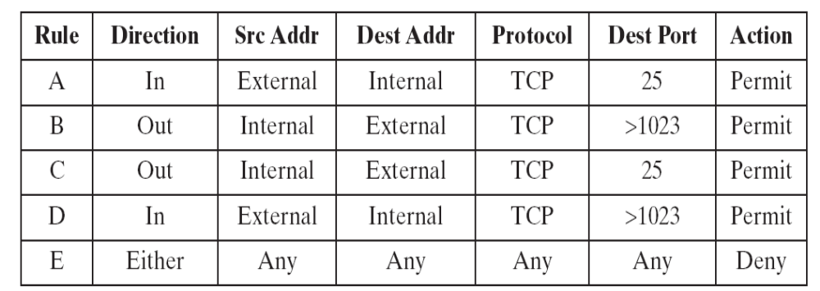
Problem No. 9
SMTP (Simple Mail Transfer Protocol) is the standard protocol for transferring mail between hosts over TCP. A TCP connection is set up between a user agent and a server program. The server listens on TCP port 25 for incoming connection requests. The user end of the connection is on a TCP port number above 1023. Suppose you wish to build a packet filter rule set allowing inbound and outbound SMTP traffic. You generate the following ruleset. Describe the effect of each rule.

